Slide 1
Heart disease Modeling
Likhithasree Kommineni
Anto Lourdu Xavier Raj Arockia Selvarathinam
Kyle Kane

Slide 2
Overview
Introduction
Models that were used
Results of the models
Takeaways of the project
Conclusion

Slide 3

Why Choose Heart Disease?

Slide 4
Reasons for Modeling heart disease
It is one of the leading causes of death worldwide
There are many factors that contribute to heart disease so nonparametric models may perform well
There are adequate datasets on heart disease that can be used
Understanding how to model heart disease can help us know where the current state of knowledge is on the topic

Slide 5
A glimpse at the data set
253,680 patients
Measured 21 independent variables
These variables contain a mix of categorical and numerical variables
Sourced from kaggle

Slide 6
What models were selected?

Slide 7
Logistic Regression
Supervised machine learning
Can be used to predict categorical variables
Estimates the probability of an event occurring

Slide 8
K nearest neighbor
Supervised learning
Non parametric
Uses distance
Can be used for both classification and regression

Slide 9

Decision Tree
Supervised learning
Non parametric
Can be used for classification and regression
Has hierarchical tree like structure

Slide 10
Random forest
Creates multiple decision trees
Supervised learning model
Useful for both classification and regression
More complex visualization compared to decision trees

Slide 11
Neural network
Modeled after the synapses of the brain
Multilayered
Input layer
hidden layer(s)
output layer
Nonlinear and harder to visualize than other models
Useful for detecting all possible interactions

Slide 12
Results from the various models

Slide 13
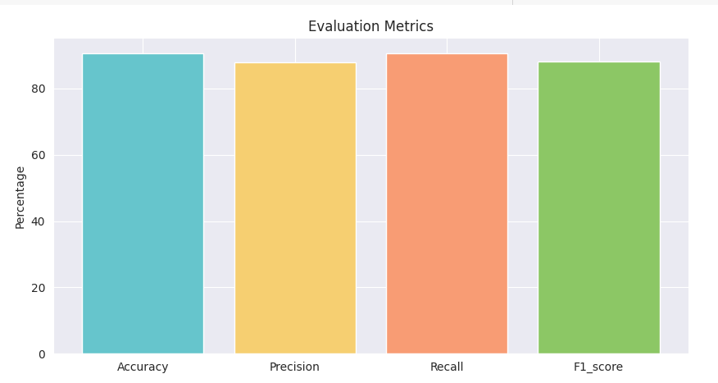
Logistic regression results graph

Slide 14
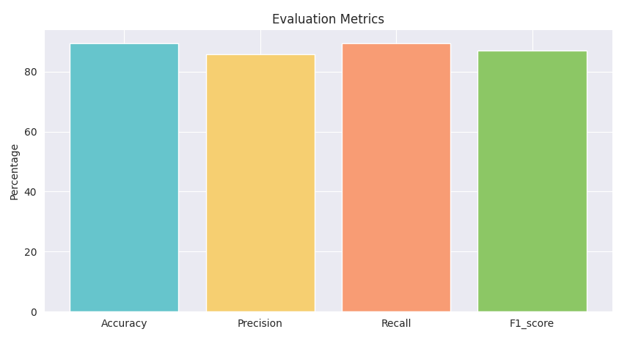
K nearest neighbor results graph

Slide 15
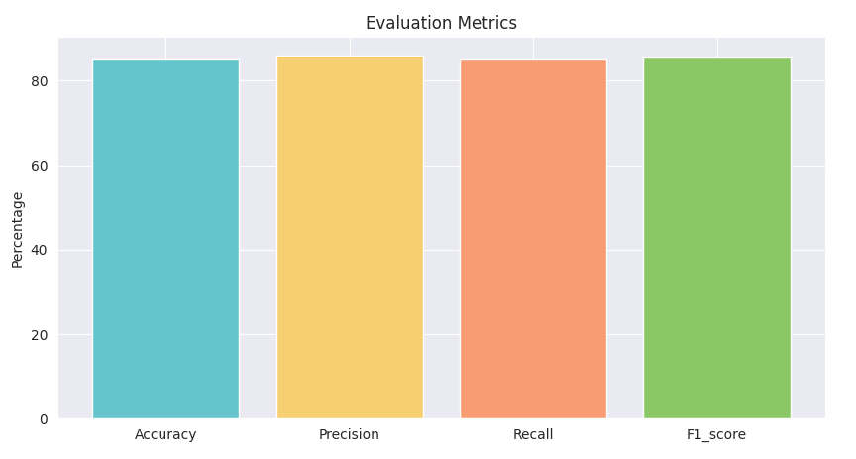
Decision tree results graph

Slide 16
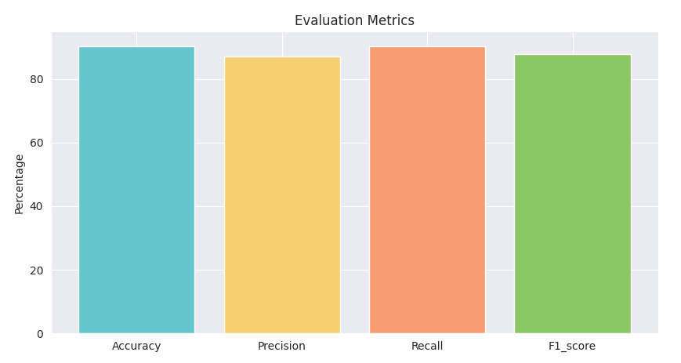
Random forest model results graph

Slide 17

Neural network results graph

Slide 18
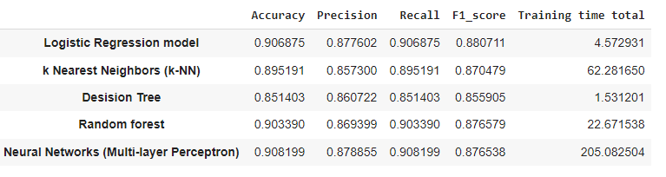
Results table

Slide 19
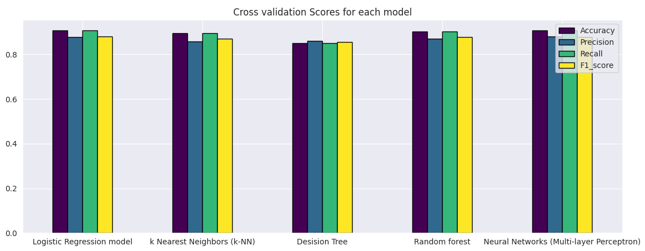
Results graph

Slide 20
Key takeaways
Neural network and logistic regression models performed the best
Random forest performed better than decision tree
Decision tree performed the worst
Overall though all 5 performed well

Slide 21
Issues faced during the project
Combining 2 datasets proved to be difficult based on the difference in size
Finding appropriate datasets for what we were looking to do with them

Slide 22
Conclusion
The variables used were able to successfully predict outcome of a patient getting heart disease
Other variables may further improve the accuracy such as genetics
Logistic regression and neural networks are best options to model heart disease

Slide 23
THANK YOU
Questions?

